Slide 1
Using Access to mine data

Slide 2
Ppt covers
Access query interface
Organizing, strategizing queries
Exporting data to excel
Employing basic statistics and formulae in excel

Slide 3
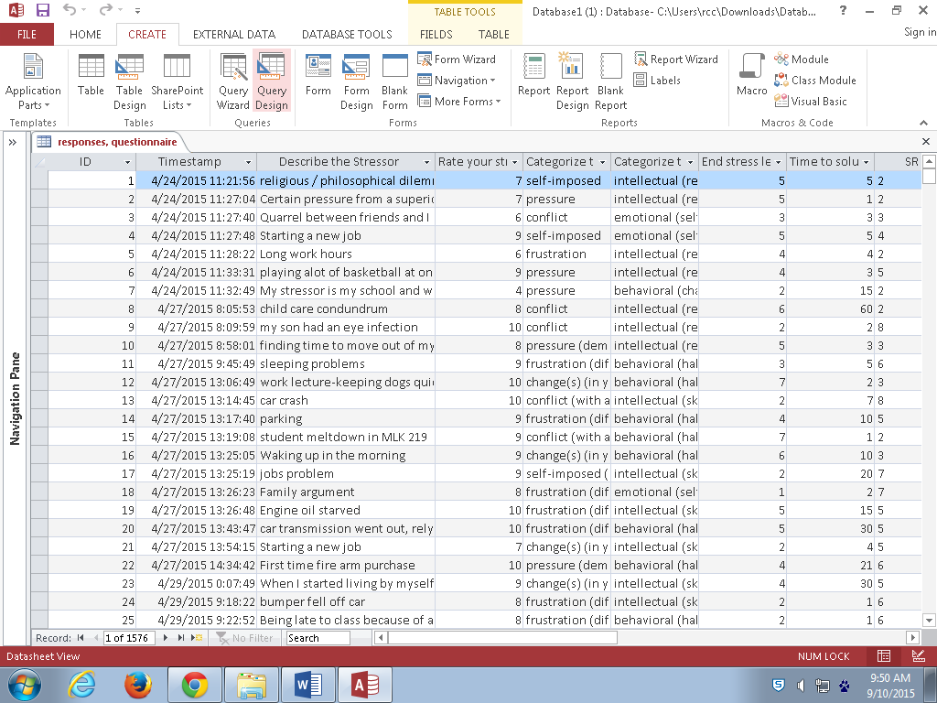

Slide 4
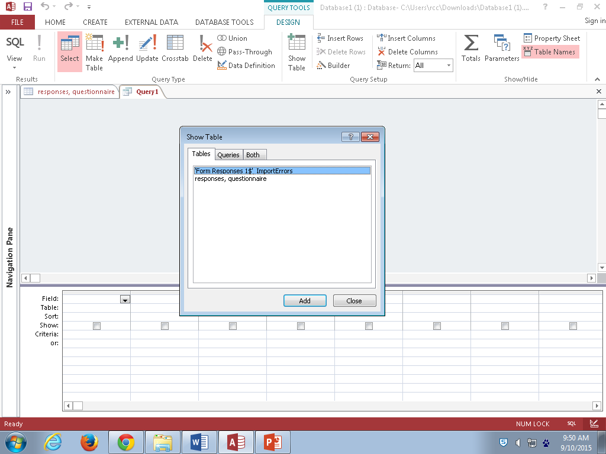

Slide 5
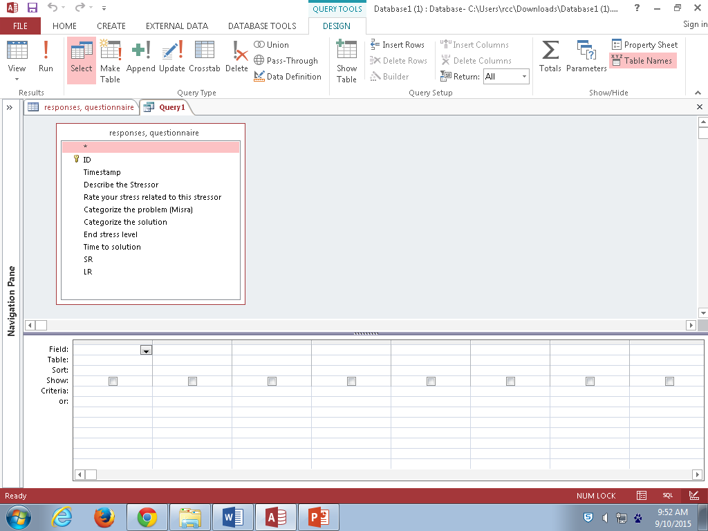

Slide 6
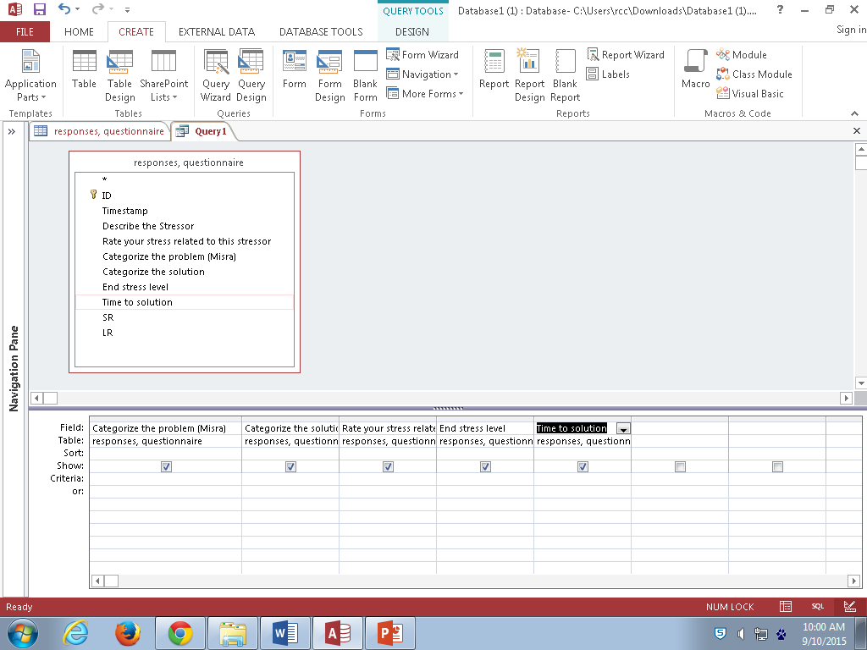

Slide 7
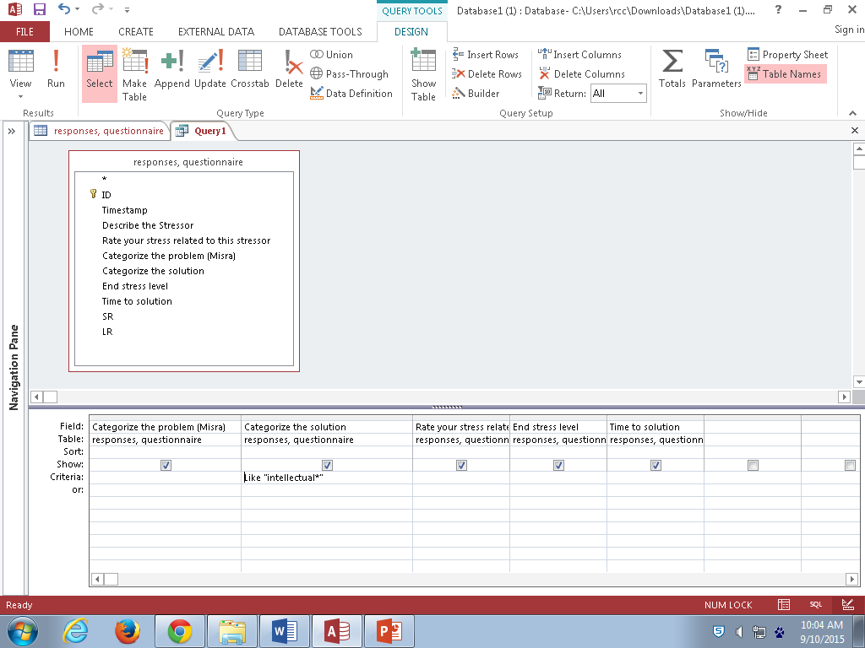

Slide 8
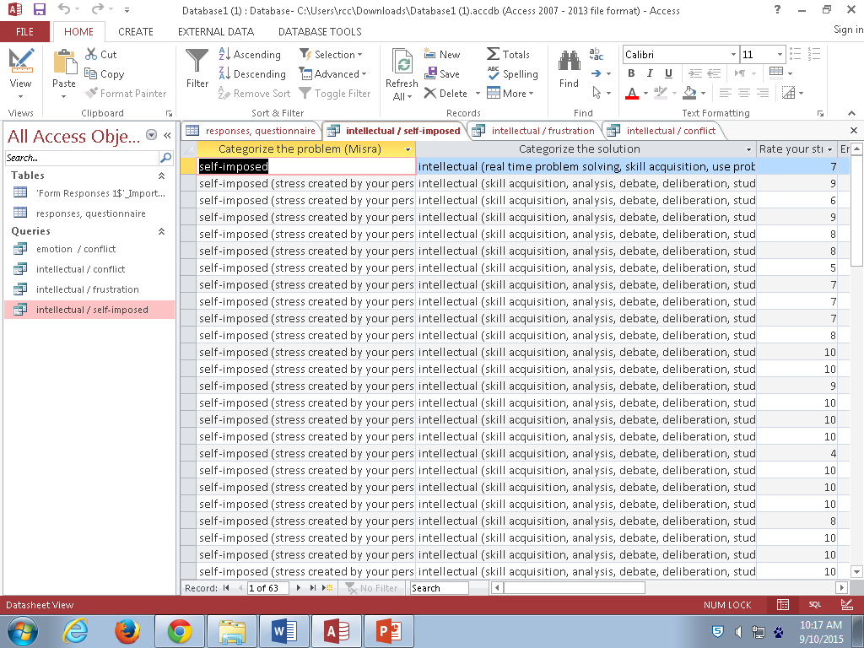

Slide 9
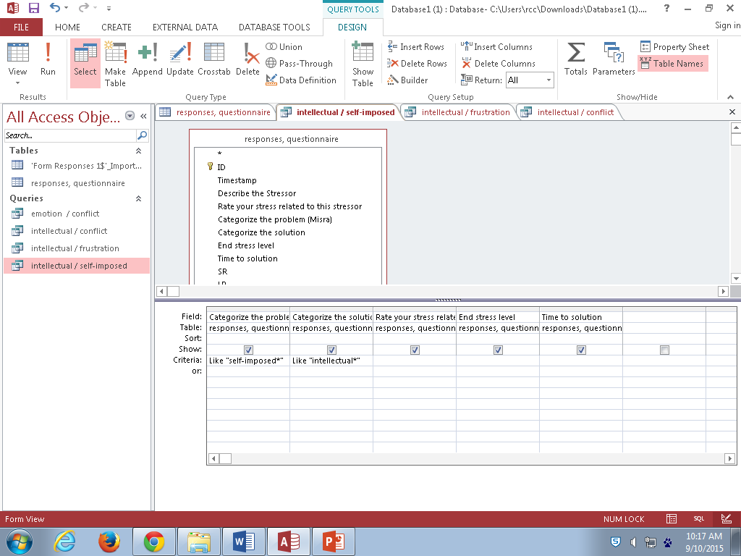

Slide 10
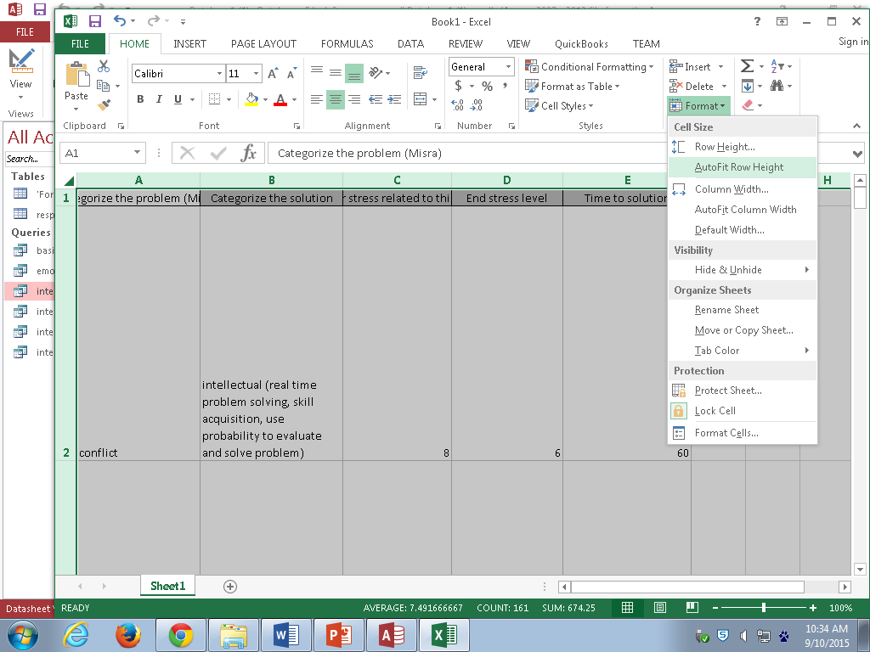

Slide 11
